Slide 1
The Distance From a Point to a Plane

Slide 2

The distance from the point $P_{o}(x_{o},y_{o},z_{o})$ to the plane with equation $Ax+By+Cz+D=0$ is given by the formula
$d=\frac{\left|Ax_{o}+By_{o}+Cz_{0}+D\right|}{\sqrt{A^{2}+B^{2}+C^{2}}}$

Slide 3
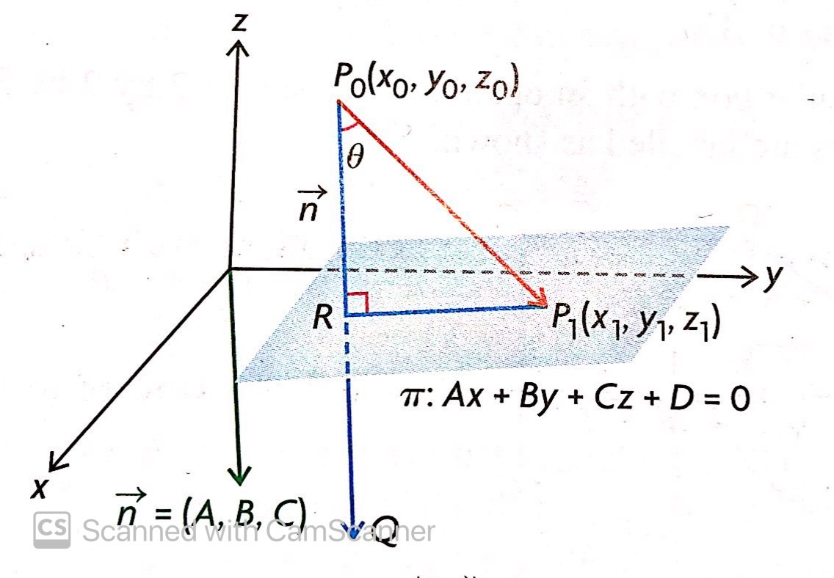
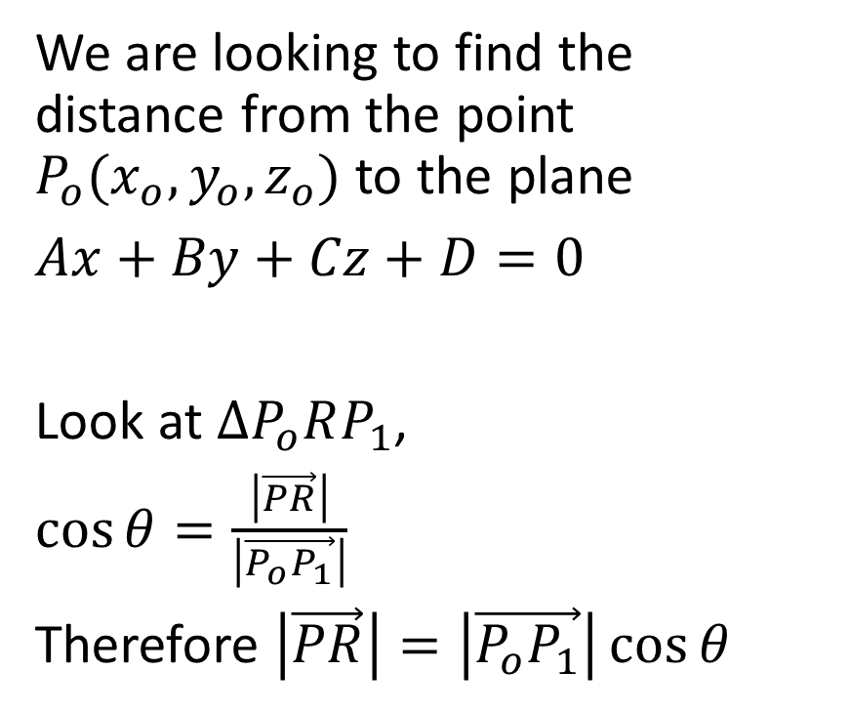
Justification of the Formula
We are looking to find the distance from the point $P_{o}(x_{o},y_{o},z_{o})$ to the plane
$Ax+By+Cz+D=0$
Look at $∆P_{o}RP_{1}$,
$\cos{θ}=\frac{\left|\vec{PR}\right|}{\left|\vec{P_{o}P_{1}}\right|}$
Therefore $\left|\vec{PR}\right|=\left|\vec{P_{o}P_{1}}\right|\cos{θ}$

Slide 4

$\left|\vec{PR}\right|=\left|\vec{P_{o}P_{1}}\right|\cos{θ}$

Slide 5
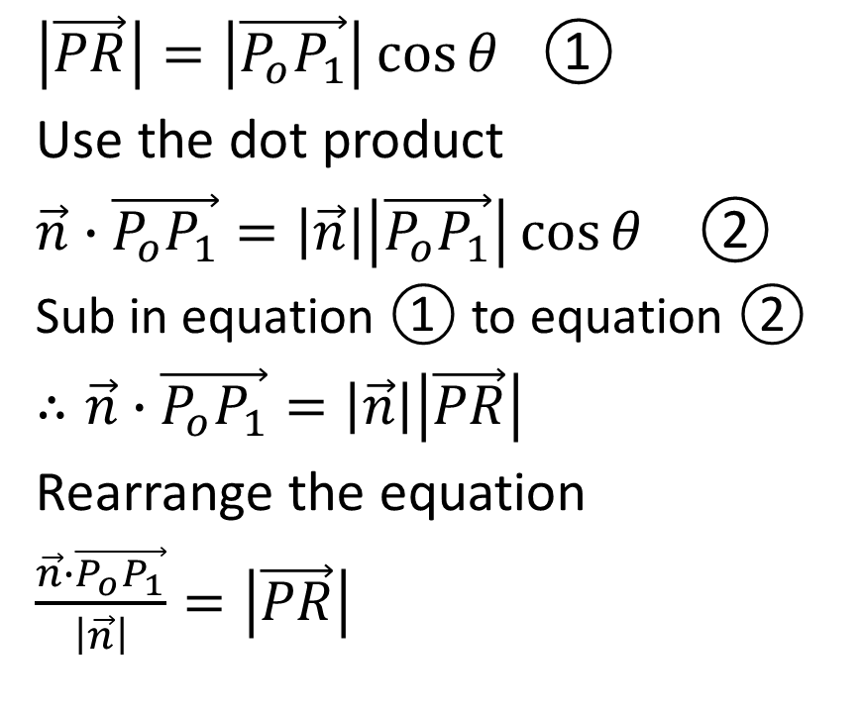
$\left|\vec{PR}\right|=\left|\vec{P_{o}P_{1}}\right|\cos{θ}$ ①
Use the dot product
$\vec{n}∙\vec{P_{o}P_{1}}=\left|\vec{n}\right|\left|\vec{P_{o}P_{1}}\right|\cos{θ}$ ②
Sub in equation ① to equation ②
$∴\vec{n}∙\vec{P_{o}P_{1}}=\left|\vec{n}\right|\left|\vec{PR}\right|$
Rearrange the equation
$\frac{\vec{n}∙\vec{P_{o}P_{1}}}{\left|\vec{n}\right|}=\left|\vec{PR}\right|$

Slide 6

$\frac{\vec{n}∙\vec{P_{o}P_{1}}}{\left|\vec{n}\right|}=\left|\vec{PR}\right|$

Slide 7
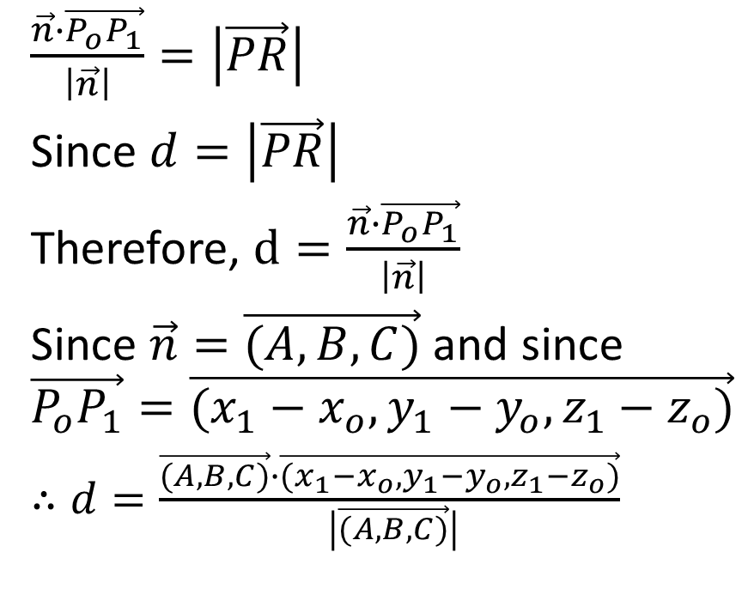
$\frac{\vec{n}∙\vec{P_{o}P_{1}}}{\left|\vec{n}\right|}=\left|\vec{PR}\right|$
Since $d=\left|\vec{PR}\right|$
Therefore, $d=\frac{\vec{n}∙\vec{P_{o}P_{1}}}{\left|\vec{n}\right|}$
Since $\vec{n}=\vec{(A,B,C)}$ and since
$$\vec{P_{o}P_{1}}=\vec{(x_{1}−x_{o},y_{1}−y_{o},z_{1}−z_{o})}$$
$∴d=\frac{\vec{(A,B,C)}∙\vec{(x_{1}−x_{o},y_{1}−y_{o},z_{1}−z_{o})}}{ \left|\vec{(A,B,C)}\right|}$

Slide 8

$d=\frac{\vec{(A,B,C)}∙\vec{(x_{1}−x_{o},y_{1}−y_{o},z_{1}−z_{o})}}{ \left|\vec{(A,B,C)}\right|}$

Slide 9
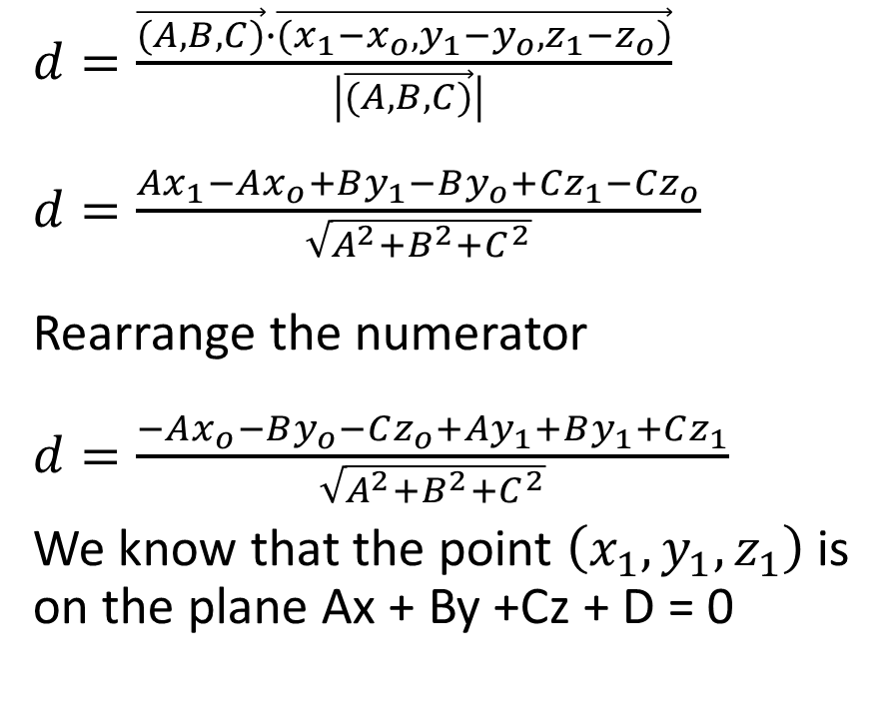
$d=\frac{\vec{(A,B,C)}∙\vec{(x_{1}−x_{o},y_{1}−y_{o},z_{1}−z_{o})}}{ \left|\vec{(A,B,C)}\right|}$
$d=\frac{Ax_{1}−Ax_{o}+By_{1}−By_{o}+Cz_{1}−Cz_{o}}{\sqrt{A^{2}+B^{2}+C^{2}}}$
Rearrange the numerator
$d=\frac{−Ax_{o}−By_{o}−Cz_{o}+Ay_{1}+By_{1}+Cz_{1}}{\sqrt{A^{2}+B^{2}+C^{2}}}$
We know that the point $\left(x_{1},y_{1},z_{1}\right)$ is on the plane Ax + By +Cz + D = 0

Slide 10
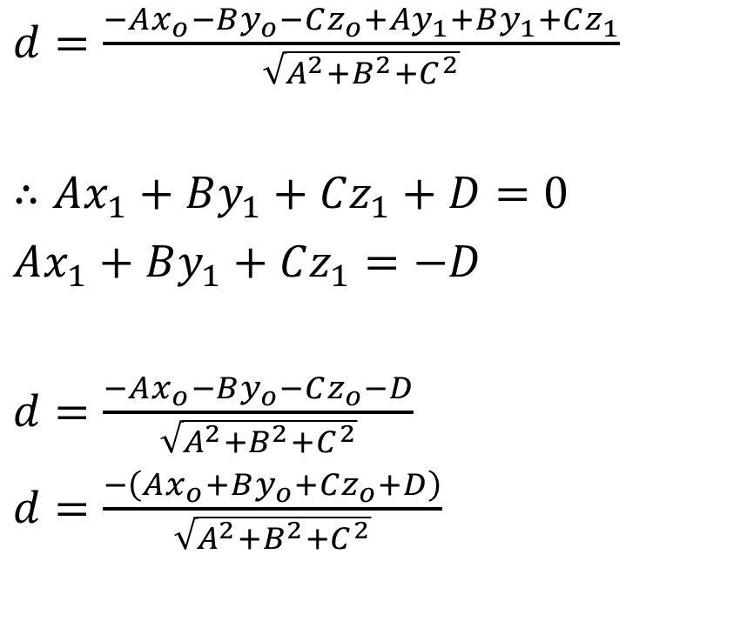
$d=\frac{−Ax_{o}−By_{o}−Cz_{o}+Ay_{1}+By_{1}+Cz_{1}}{\sqrt{A^{2}+B^{2}+C^{2}}}$
$∴Ax_{1}+By_{1}+Cz_{1}+D=0$
$Ax_{1}+By_{1}+Cz_{1}=−D$
$d=\frac{−Ax_{o}−By_{o}−Cz_{o}−D}{\sqrt{A^{2}+B^{2}+C^{2}}}$
$d=\frac{−\left(Ax_{o}+By_{o}+Cz_{o}+D\right)}{\sqrt{A^{2}+B^{2}+C^{2}}}$

Slide 11

$d=\frac{−\left(Ax_{o}+By_{o}+Cz_{o}+D\right)}{\sqrt{A^{2}+B^{2}+C^{2}}}$

Slide 12
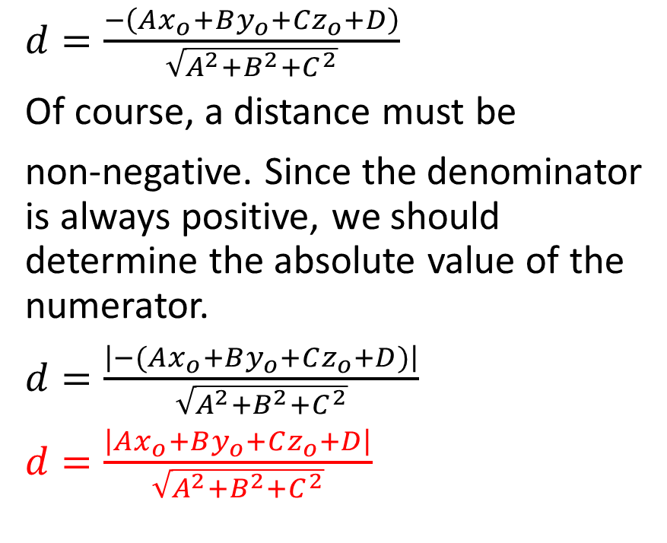
$d=\frac{−\left(Ax_{o}+By_{o}+Cz_{o}+D\right)}{\sqrt{A^{2}+B^{2}+C^{2}}}$
Of course, a distance must be
non-negative. Since the denominator is always positive, we should determine the absolute value of the numerator.
$d=\frac{\left|−(Ax_{o}+By_{o}+Cz_{o}+D)\right|}{\sqrt{A^{2}+B^{2}+C^{2}}}$
$d=\frac{\left|Ax_{o}+By_{o}+Cz_{o}+D\right|}{\sqrt{A^{2}+B^{2}+C^{2}}}$

Slide 13
Example
Determine the distance from the point S(-1,2,-4) to the plane with equation 8x – 4y + 8z + 3 = 0

Slide 14
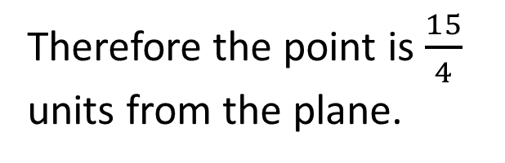
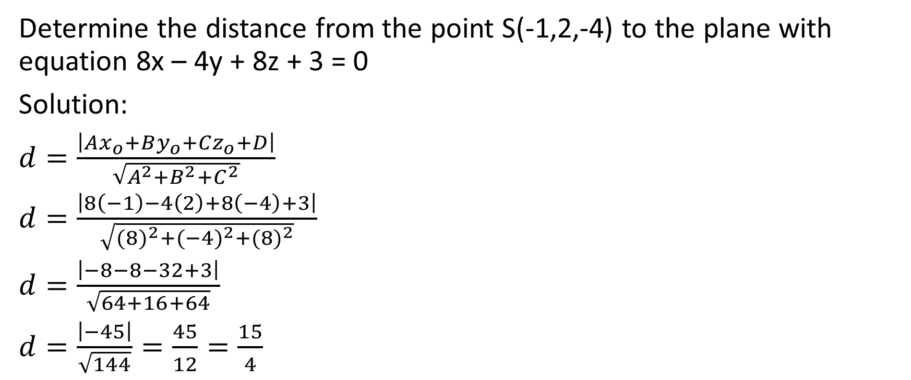
Determine the distance from the point S(-1,2,-4) to the plane with equation 8x – 4y + 8z + 3 = 0
Solution:
$d=\frac{\left|Ax_{o}+By_{o}+Cz_{o}+D\right|}{\sqrt{A^{2}+B^{2}+C^{2}}}$
$d=\frac{\left|8\left(−1\right)−4\left(2\right)+8\left(−4\right)+3\right|}{\sqrt{{(8)}^{2}+{(−4)}^{2}+{(8)}^{2}}}$
$d=\frac{\left|−8−8−32+3\right|}{\sqrt{64+16+64}}$
$d=\frac{\left|−45\right|}{\sqrt{144}}=\frac{45}{12}=\frac{15}{4}$
Therefore the point is $\frac{15}{4}$ units from the plane.

Slide 15

Example
Determine the distance between the point (9,1,-2) and the plane
$\vec{r}=\vec{(−2,1,−4)}+s\vec{(1,2,4)}+t\vec{(3,−2,−8)}$

Slide 16
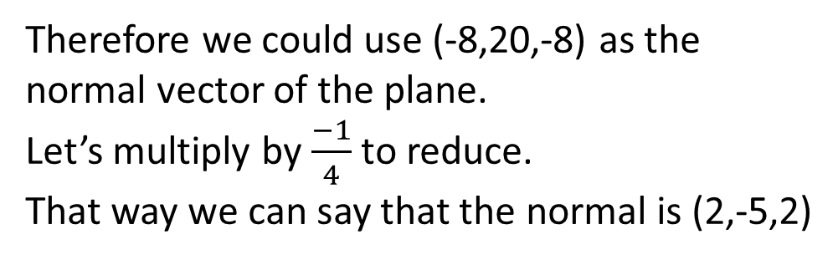

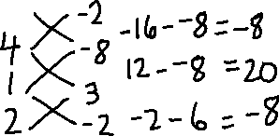
Determine the distance between the point (9,1,-2) and the plane
$\vec{r}=\vec{(−2,1,−4)}+s\vec{(1,2,4)}+t\vec{(3,−2,−8)}$
Solution:
Therefore we could use (-8,20,-8) as the normal vector of the plane.
Let’s multiply by $\frac{−1}{4}$ to reduce.
That way we can say that the normal is (2,-5,2)

Slide 17
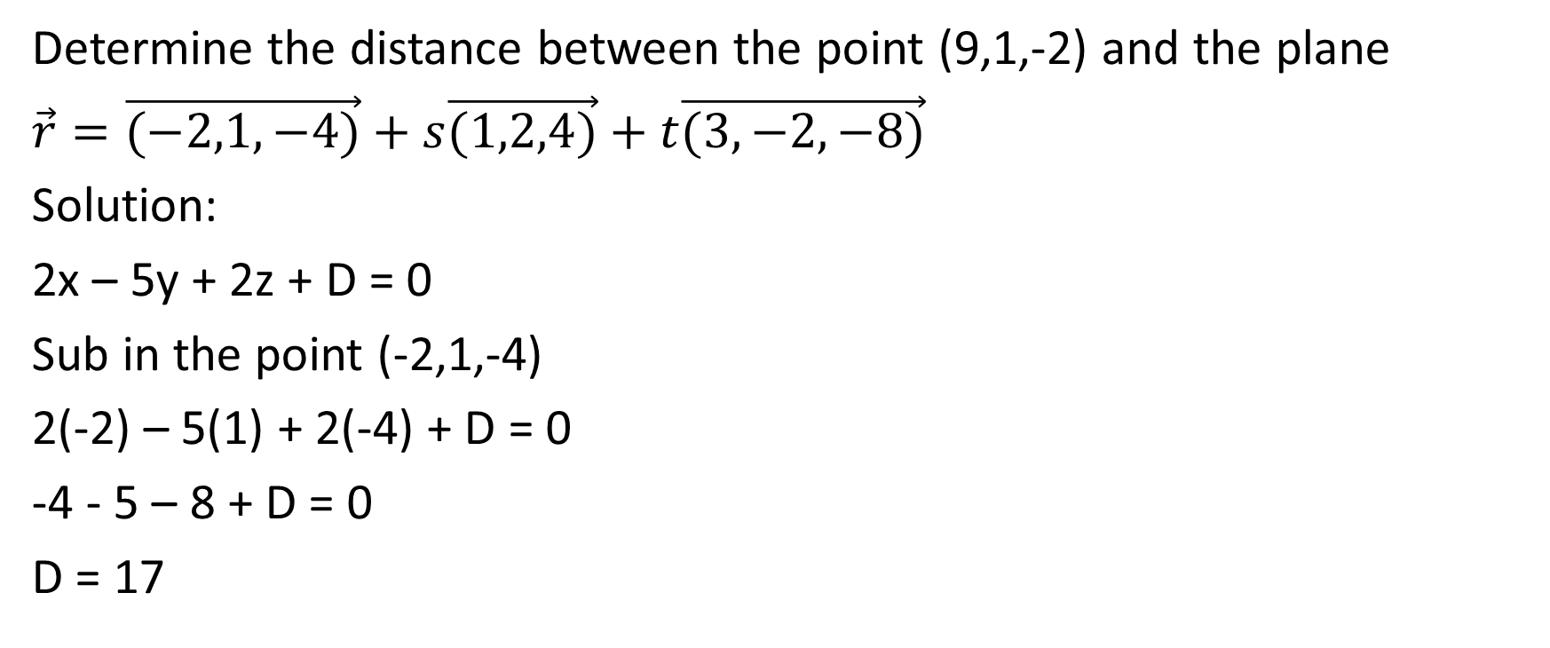
Determine the distance between the point (9,1,-2) and the plane
$\vec{r}=\vec{(−2,1,−4)}+s\vec{(1,2,4)}+t\vec{(3,−2,−8)}$
Solution:
2x – 5y + 2z + D = 0
Sub in the point (-2,1,-4)
2(-2) – 5(1) + 2(-4) + D = 0
-4 - 5 – 8 + D = 0
D = 17

Slide 18
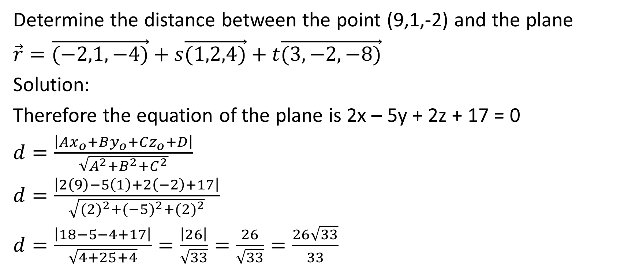
Determine the distance between the point (9,1,-2) and the plane
$\vec{r}=\vec{(−2,1,−4)}+s\vec{(1,2,4)}+t\vec{(3,−2,−8)}$
Solution:
Therefore the equation of the plane is 2x – 5y + 2z + 17 = 0
$d=\frac{\left|Ax_{o}+By_{o}+Cz_{o}+D\right|}{\sqrt{A^{2}+B^{2}+C^{2}}}$
$d=\frac{\left|2\left(9\right)−5\left(1\right)+2\left(−2\right)+17\right|}{\sqrt{{(2)}^{2}+{(−5)}^{2}+{(2)}^{2}}}$
$d=\frac{\left|18−5−4+17\right|}{\sqrt{4+25+4}}=\frac{\left|26\right|}{\sqrt{33}}=\frac{26}{\sqrt{33}}=\frac{26\sqrt{33}}{33}$

Slide 19
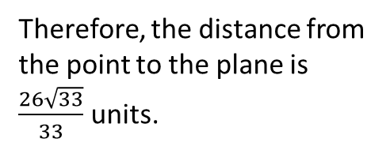
Determine the distance between the point (9,1,-2) and the plane
$\vec{r}=\vec{(−2,1,−4)}+s\vec{(1,2,4)}+t\vec{(3,−2,−8)}$
Solution:
Therefore the equation of the plane is 2x – 5y + 2z + 17 = 0
$d=\frac{\left|Ax_{o}+By_{o}+Cz_{o}+D\right|}{\sqrt{A^{2}+B^{2}+C^{2}}}$
$d=\frac{\left|2\left(9\right)−5\left(1\right)+2\left(−2\right)+17\right|}{\sqrt{{(2)}^{2}+{(−5)}^{2}+{(2)}^{2}}}$
$d=\frac{\left|18−5−4+17\right|}{\sqrt{4+25+4}}=\frac{\left|26\right|}{\sqrt{33}}=\frac{26}{\sqrt{33}}=\frac{26\sqrt{33}}{33}$
Therefore, the distance from the point to the plane is $\frac{26\sqrt{33}}{33}$ units.

Slide 20

Example
Determine the distance between the two planes
$π_{1}:2x−y+2z+4=0$ and $π_{2}:2x−y+2z+16=0$

Slide 21
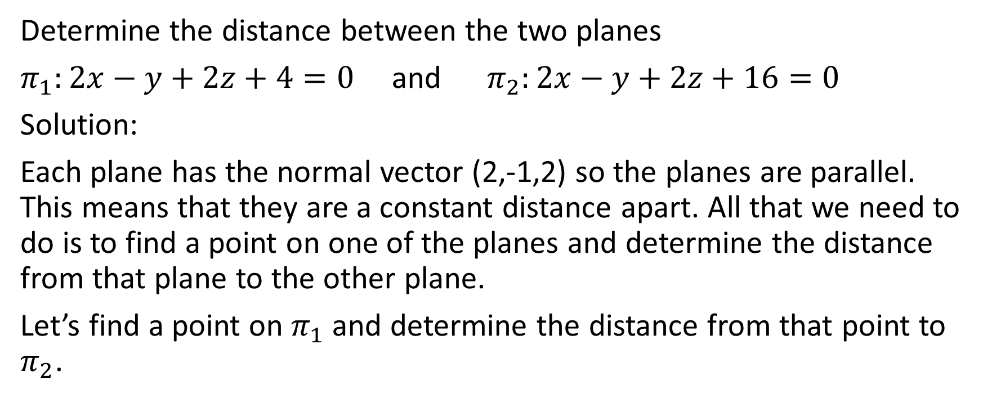
Determine the distance between the two planes
$π_{1}:2x−y+2z+4=0$ and $π_{2}:2x−y+2z+16=0$
Solution:
Each plane has the normal vector (2,-1,2) so the planes are parallel. This means that they are a constant distance apart. All that we need to do is to find a point on one of the planes and determine the distance from that plane to the other plane.
Let’s find a point on $π_{1}$ and determine the distance from that point to $π_{2}$.

Slide 22
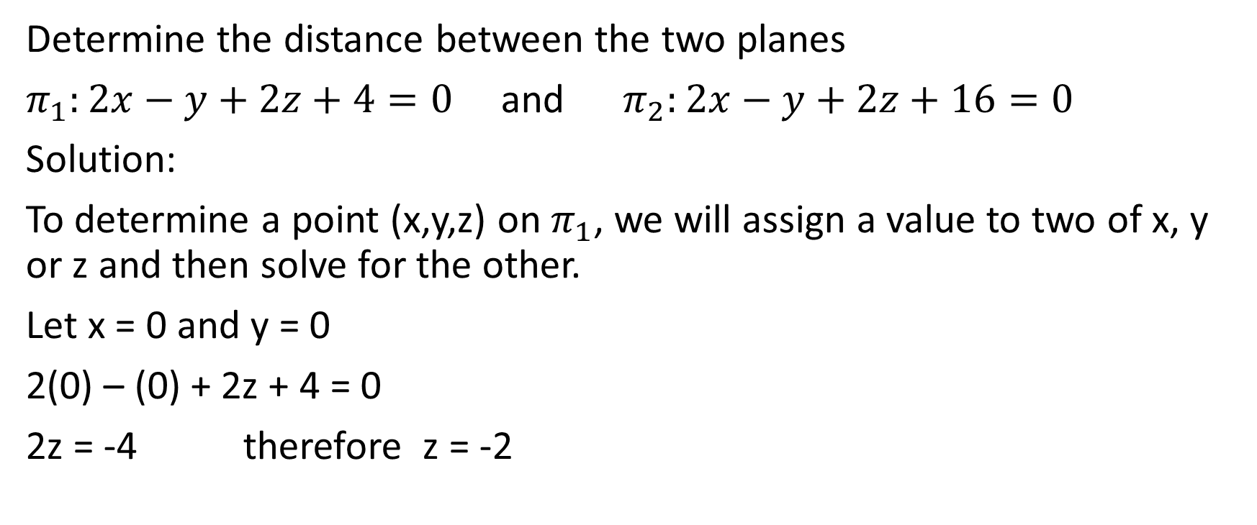
Determine the distance between the two planes
$π_{1}:2x−y+2z+4=0$ and $π_{2}:2x−y+2z+16=0$
Solution:
To determine a point (x,y,z) on $π_{1}$, we will assign a value to two of x, y or z and then solve for the other.
Let x = 0 and y = 0
2(0) – (0) + 2z + 4 = 0
2z = -4 therefore z = -2

Slide 23
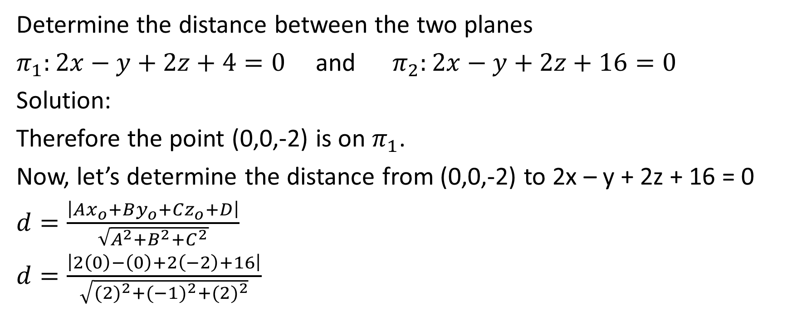
Determine the distance between the two planes
$π_{1}:2x−y+2z+4=0$ and $π_{2}:2x−y+2z+16=0$
Solution:
Therefore the point (0,0,-2) is on $π_{1}$.
Now, let’s determine the distance from (0,0,-2) to 2x – y + 2z + 16 = 0
$d=\frac{\left|Ax_{o}+By_{o}+Cz_{o}+D\right|}{\sqrt{A^{2}+B^{2}+C^{2}}}$
$d=\frac{\left|2\left(0\right)−\left(0\right)+2\left(−2\right)+16\right|}{\sqrt{{(2)}^{2}+{(−1)}^{2}+{(2)}^{2}}}$

Slide 24

Determine the distance between the two planes
$π_{1}:2x−y+2z+4=0$ and $π_{2}:2x−y+2z+16=0$
Solution:
$d=\frac{\left|2\left(0\right)−\left(0\right)+2\left(−2\right)+16\right|}{\sqrt{{(2)}^{2}+{(−1)}^{2}+{(2)}^{2}}}$

Slide 25
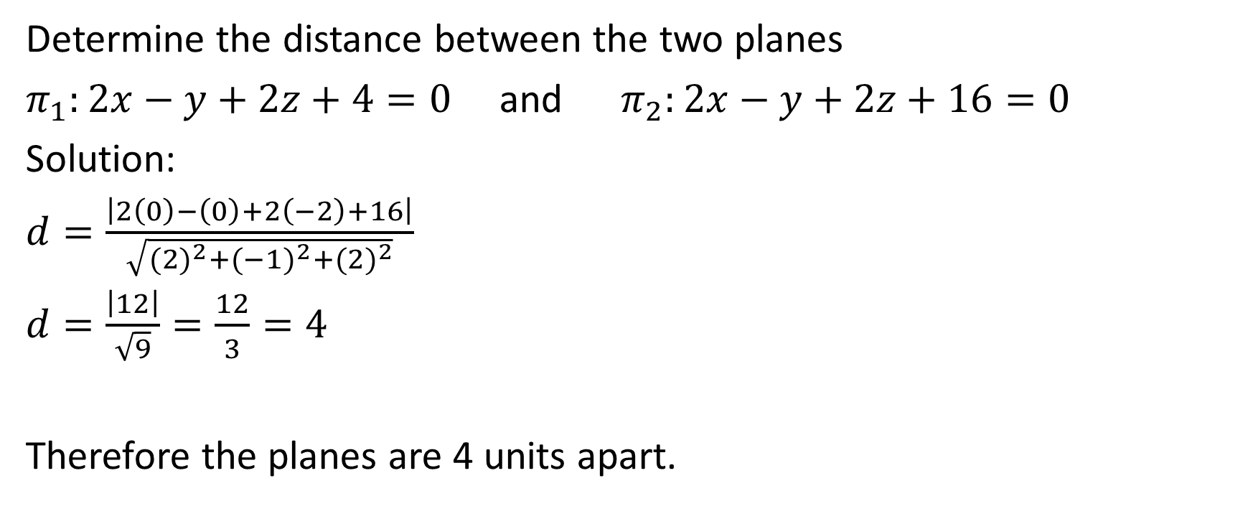
Determine the distance between the two planes
$π_{1}:2x−y+2z+4=0$ and $π_{2}:2x−y+2z+16=0$
Solution:
$d=\frac{\left|2\left(0\right)−\left(0\right)+2\left(−2\right)+16\right|}{\sqrt{{(2)}^{2}+{(−1)}^{2}+{(2)}^{2}}}$
$d=\frac{\left|12\right|}{\sqrt{9}}=\frac{12}{3}=4$
Therefore the planes are 4 units apart.

Slide 26

Example
Determine the shortest distance between the two skew line
$L_{1}:\vec{r}=\left(0,2,4\right)+t(1,−2,1)$ and $L_{2}:\vec{r}=\left(−2,−5,4\right)+s(1,0,−1)$

Slide 27
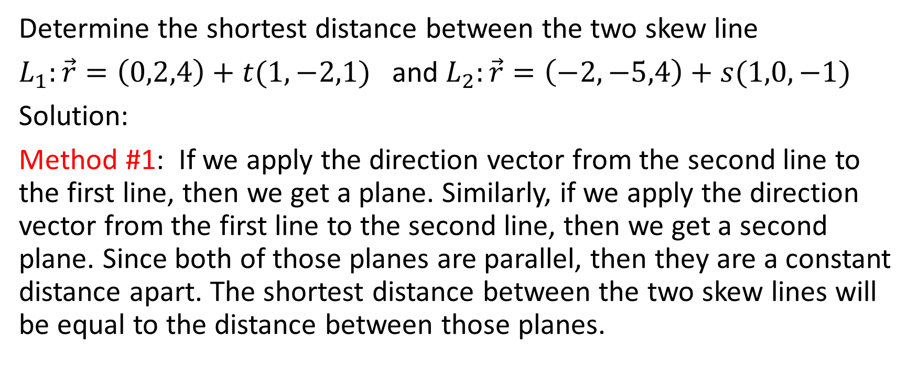
Determine the shortest distance between the two skew line
$L_{1}:\vec{r}=\left(0,2,4\right)+t(1,−2,1)$ and $L_{2}:\vec{r}=\left(−2,−5,4\right)+s(1,0,−1)$
Solution:
Method #1: If we apply the direction vector from the second line to the first line, then we get a plane. Similarly, if we apply the direction vector from the first line to the second line, then we get a second plane. Since both of those planes are parallel, then they are a constant distance apart. The shortest distance between the two skew lines will be equal to the distance between those planes.

Slide 28

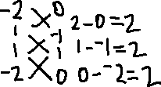
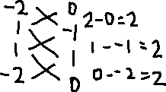
Determine the shortest distance between the two skew line
$L_{1}:\vec{r}=\left(0,2,4\right)+t(1,−2,1)$ and $L_{2}:\vec{r}=\left(−2,−5,4\right)+s(1,0,−1)$
Solution:
$π_{1}:\vec{r}=\left(0,2,4\right)+t\left(1,−2,1\right)+s(1,0,−1)$ $π_{2}:\vec{r}=\left(−2,−5,4\right)+t\left(1,−2,1\right)+s(1,0,−1)$

Slide 29
Determine the shortest distance between the two skew line
$L_{1}:\vec{r}=\left(0,2,4\right)+t(1,−2,1)$ and $L_{2}:\vec{r}=\left(−2,−5,4\right)+s(1,0,−1)$
Solution:
$π_{1}:\vec{r}=\left(0,2,4\right)+t\left(1,−2,1\right)+s(1,0,−1)$ $π_{2}:\vec{r}=\left(−2,−5,4\right)+t\left(1,−2,1\right)+s(1,0,−1)$
We could say that the normal is (2,2,2), but we’ll reduce it and say that the normal is (1,1,1)
We could say that the normal is (2,2,2), but we’ll reduce it and say that the normal is (1,1,1)

Slide 30
Determine the shortest distance between the two skew line
$L_{1}:\vec{r}=\left(0,2,4\right)+t(1,−2,1)$ and $L_{2}:\vec{r}=\left(−2,−5,4\right)+s(1,0,−1)$
Solution:
$π_{1}:\vec{r}=\left(0,2,4\right)+t\left(1,−2,1\right)+s(1,0,−1)$ $π_{2}:\vec{r}=\left(−2,−5,4\right)+t\left(1,−2,1\right)+s(1,0,−1)$
Since the normal is (1,1,1), therefore the equation of the plane is x + y + z + D = 0. Sub in the point (0,2,4).
0 + 2 + 4 + D = 0
D = -6
Therefore the equation of the plane is
x + y + z – 6 = 0
Since the normal is (1,1,1), therefore the equation of the plane is x + y + z + D = 0.
Sub in the point (-2, -5, 4).
-2 – 5 + 4 + D = 0
D = 3
Therefore the equation of the plane is
x + y + z + 3 = 0

Slide 31
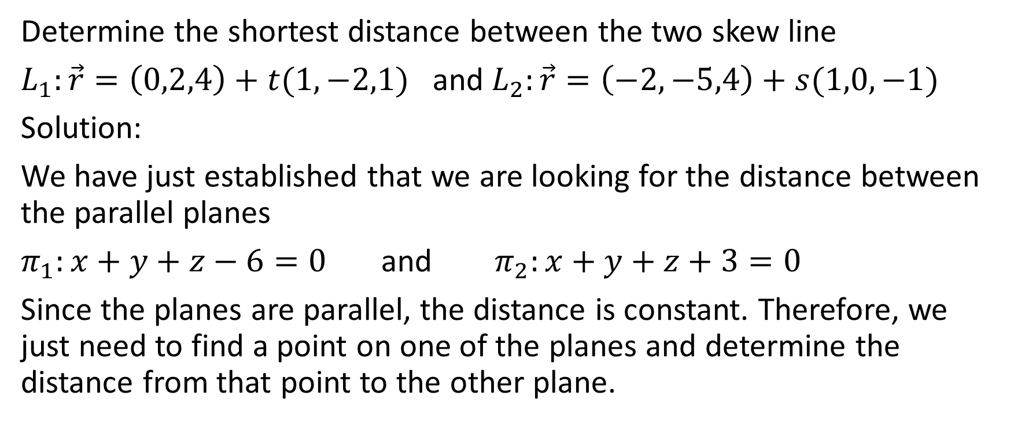
Determine the shortest distance between the two skew line
$L_{1}:\vec{r}=\left(0,2,4\right)+t(1,−2,1)$ and $L_{2}:\vec{r}=\left(−2,−5,4\right)+s(1,0,−1)$
Solution:
We have just established that we are looking for the distance between the parallel planes
$π_{1}:x+y+z−6=0$ and $π_{2}:x+y+z+3=0$
Since the planes are parallel, the distance is constant. Therefore, we just need to find a point on one of the planes and determine the distance from that point to the other plane.

Slide 32

Determine the shortest distance between the two skew line
$L_{1}:\vec{r}=\left(0,2,4\right)+t(1,−2,1)$ and $L_{2}:\vec{r}=\left(−2,−5,4\right)+s(1,0,−1)$
Solution:
$π_{1}:x+y+z−6=0$ and $π_{2}:x+y+z+3=0$

Slide 33
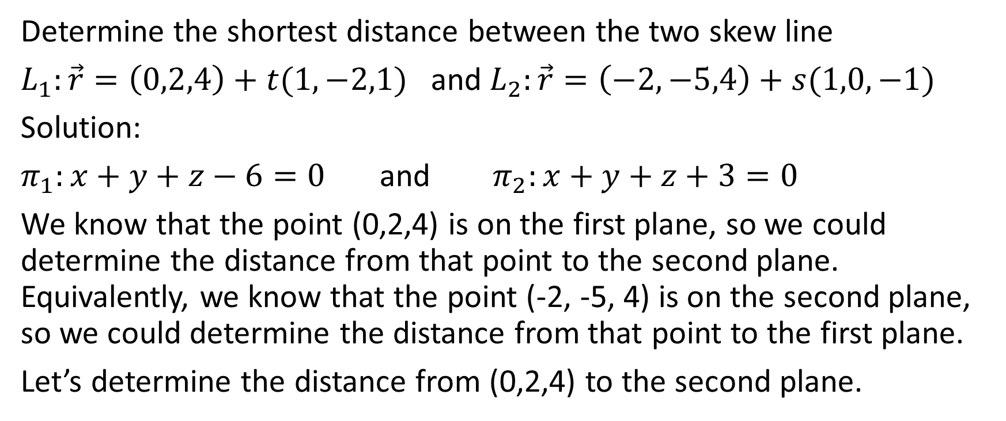
Determine the shortest distance between the two skew line
$L_{1}:\vec{r}=\left(0,2,4\right)+t(1,−2,1)$ and $L_{2}:\vec{r}=\left(−2,−5,4\right)+s(1,0,−1)$
Solution:
$π_{1}:x+y+z−6=0$ and $π_{2}:x+y+z+3=0$
We know that the point (0,2,4) is on the first plane, so we could determine the distance from that point to the second plane. Equivalently, we know that the point (-2, -5, 4) is on the second plane, so we could determine the distance from that point to the first plane.
Let’s determine the distance from (0,2,4) to the second plane.

Slide 34
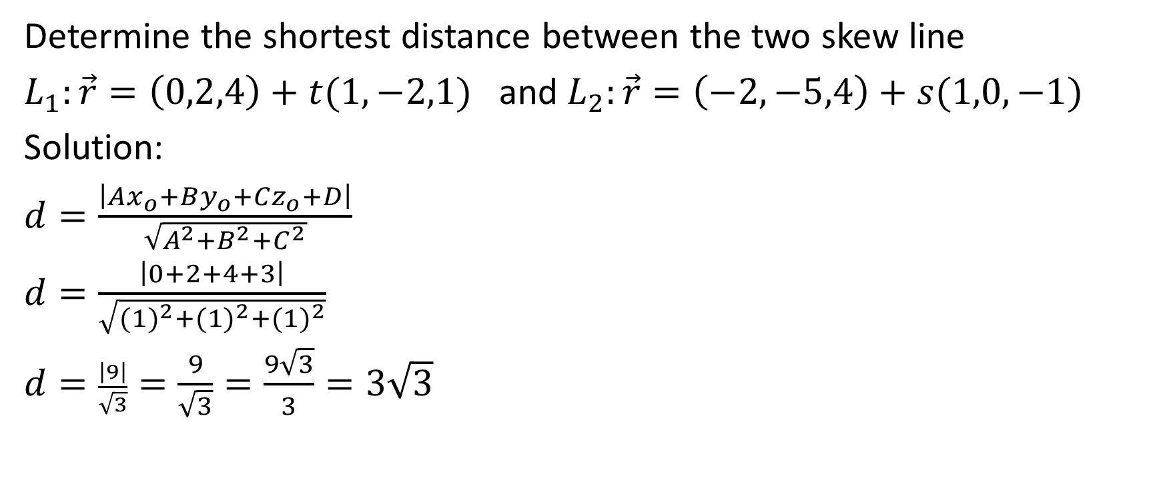
Determine the shortest distance between the two skew line
$L_{1}:\vec{r}=\left(0,2,4\right)+t(1,−2,1)$ and $L_{2}:\vec{r}=\left(−2,−5,4\right)+s(1,0,−1)$
Solution:
$d=\frac{\left|Ax_{o}+By_{o}+Cz_{o}+D\right|}{\sqrt{A^{2}+B^{2}+C^{2}}}$
$d=\frac{\left|0+2+4+3\right|}{\sqrt{{(1)}^{2}+{(1)}^{2}+{(1)}^{2}}}$
$d=\frac{\left|9\right|}{\sqrt{3}}=\frac{9}{\sqrt{3}}=\frac{9\sqrt{3}}{3}=3\sqrt{3}$

Slide 35
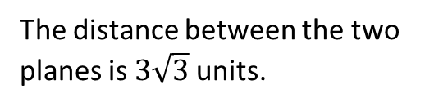
Determine the shortest distance between the two skew line
$L_{1}:\vec{r}=\left(0,2,4\right)+t(1,−2,1)$ and $L_{2}:\vec{r}=\left(−2,−5,4\right)+s(1,0,−1)$
Solution:
$d=\frac{\left|Ax_{o}+By_{o}+Cz_{o}+D\right|}{\sqrt{A^{2}+B^{2}+C^{2}}}$
$d=\frac{\left|0+2+4+3\right|}{\sqrt{{(1)}^{2}+{(1)}^{2}+{(1)}^{2}}}$
$d=\frac{\left|9\right|}{\sqrt{3}}=\frac{9}{\sqrt{3}}=\frac{9\sqrt{3}}{3}=3\sqrt{3}$
The distance between the two planes is $3\sqrt{3}$ units.

Slide 36

Determine the shortest distance between the two skew line
$L_{1}:\vec{r}=\left(0,2,4\right)+t(1,−2,1)$ and $L_{2}:\vec{r}=\left(−2,−5,4\right)+s(1,0,−1)$
Solution:
$d=\frac{\left|Ax_{o}+By_{o}+Cz_{o}+D\right|}{\sqrt{A^{2}+B^{2}+C^{2}}}$
$d=\frac{\left|0+2+4+3\right|}{\sqrt{{(1)}^{2}+{(1)}^{2}+{(1)}^{2}}}$
$d=\frac{\left|9\right|}{\sqrt{3}}=\frac{9}{\sqrt{3}}=\frac{9\sqrt{3}}{3}=3\sqrt{3}$
The distance between the two planes is $3\sqrt{3}$ units.
Therefore, the distance between the skew lines is 3$\sqrt{3}$ units

Slide 37
You may have noticed that to use this method, you don’t actually have to find the equation of each plane. Just find the equation of one of the planes, then use the position vector from the other line and determine the distance from that point to the other plane.

Slide 38
You may have noticed that to use this method, you don’t actually have to find the equation of each plane. Just find the equation of one of the planes, then use the position vector from the other line and determine the distance from that point to the other plane.
For example, you could take the direction vector from line 2 and add it to line 1 to come up with a plane. Then, think of the position vector from line 2 as a point and determine the distance from that point to the plane you just created. This would save a few of the steps that we just did.

Slide 39
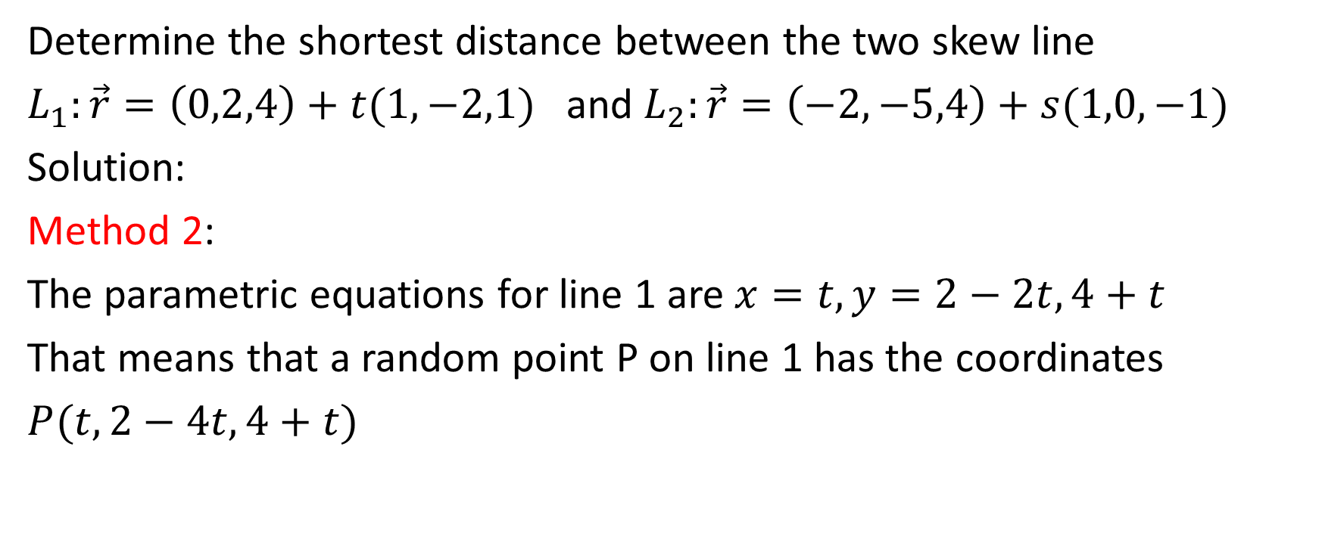
Back to the Same Question
Determine the shortest distance between the two skew line
$L_{1}:\vec{r}=\left(0,2,4\right)+t(1,−2,1)$ and $L_{2}:\vec{r}=\left(−2,−5,4\right)+s(1,0,−1)$
Solution:
Method 2:
The parametric equations for line 1 are $x=t,y=2−2t,4+t$
That means that a random point P on line 1 has the coordinates
$P(t,2−4t,4+t)$

Slide 40
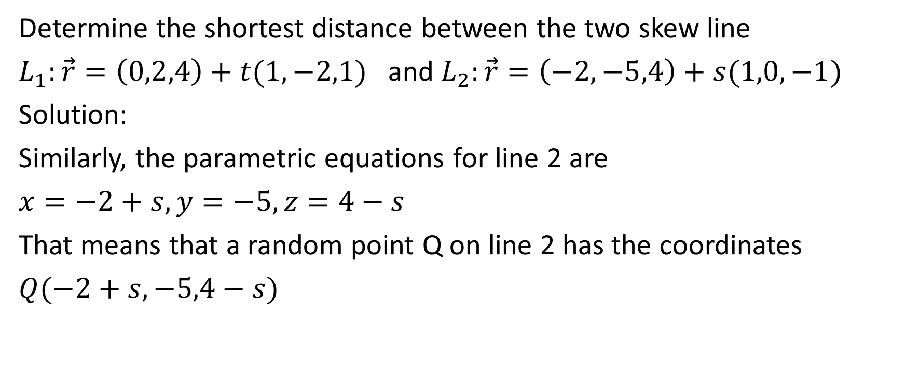
Determine the shortest distance between the two skew line
$L_{1}:\vec{r}=\left(0,2,4\right)+t(1,−2,1)$ and $L_{2}:\vec{r}=\left(−2,−5,4\right)+s(1,0,−1)$
Solution:
Similarly, the parametric equations for line 2 are
$x=−2+s,y=−5,z=4−s$
That means that a random point Q on line 2 has the coordinates
$Q(−2+s,−5,4−s)$

Slide 41
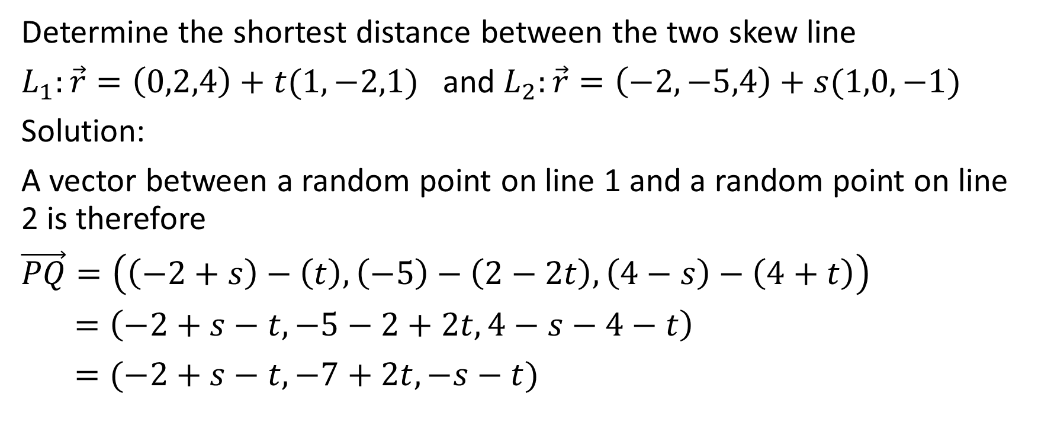
Determine the shortest distance between the two skew line
$L_{1}:\vec{r}=\left(0,2,4\right)+t(1,−2,1)$ and $L_{2}:\vec{r}=\left(−2,−5,4\right)+s(1,0,−1)$
Solution:
A vector between a random point on line 1 and a random point on line 2 is therefore
$\vec{PQ}=\left(\left(−2+s\right)−\left(t\right),\left(−5\right)−\left(2−2t\right),\left(4−s\right)−\left(4+t\right)\right)$
$=\left(−2+s−t,−5−2+2t,4−s−4−t\right)$
$=(−2+s−t,−7+2t,−s−t)$

Slide 42
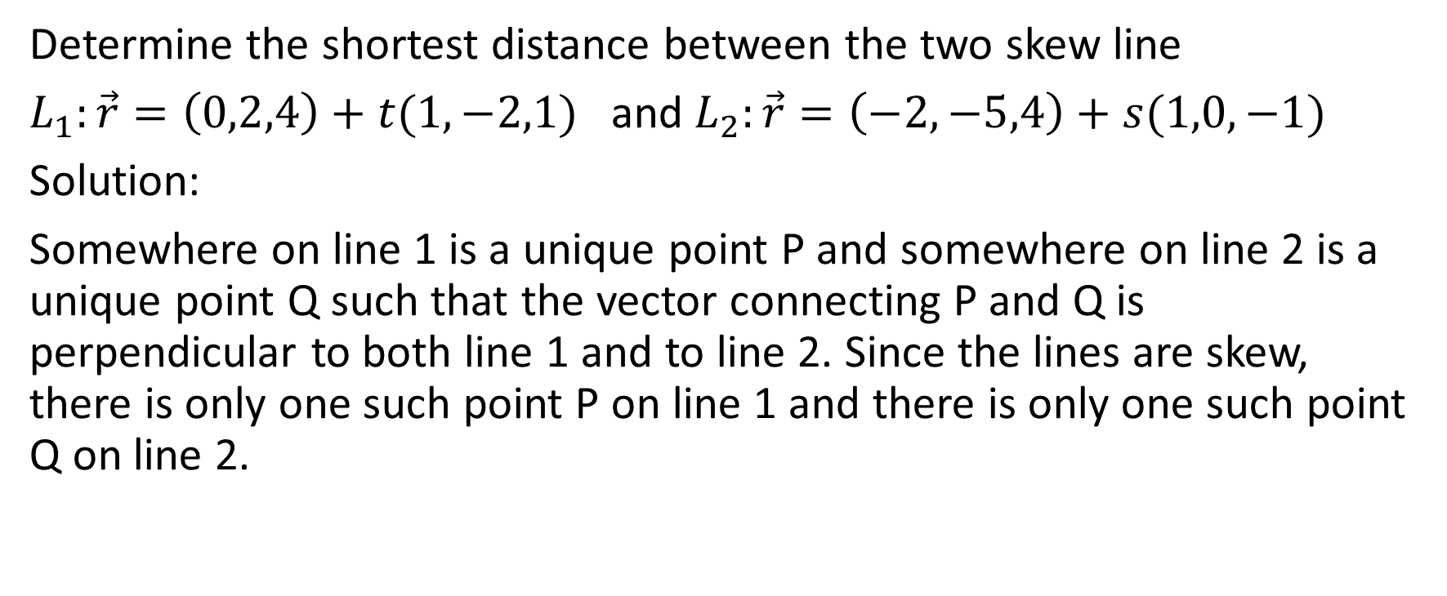
Determine the shortest distance between the two skew line
$L_{1}:\vec{r}=\left(0,2,4\right)+t(1,−2,1)$ and $L_{2}:\vec{r}=\left(−2,−5,4\right)+s(1,0,−1)$
Solution:
Somewhere on line 1 is a unique point P and somewhere on line 2 is a unique point Q such that the vector connecting P and Q is perpendicular to both line 1 and to line 2. Since the lines are skew, there is only one such point P on line 1 and there is only one such point Q on line 2.

Slide 43

Determine the shortest distance between the two skew line
$L_{1}:\vec{r}=\left(0,2,4\right)+t(1,−2,1)$ and $L_{2}:\vec{r}=\left(−2,−5,4\right)+s(1,0,−1)$
Solution:
.
Note that this is an attempt to draw (on a two-dimensional surface) skew lines in R³ so the drawing will not be ideal.
Line 2
.
Line 1

Slide 44



Determine the shortest distance between the two skew line
$L_{1}:\vec{r}=\left(0,2,4\right)+t(1,−2,1)$ and $L_{2}:\vec{r}=\left(−2,−5,4\right)+s(1,0,−1)$
Solution:
.
$$Q(−2+s,−5,4−s)$$
Note that this is an attempt to draw (on a two-dimensional surface) skew lines in R³ so the drawing will not be ideal.
Line 2
.
Line 1
$P(t,2−2t,4+t$)
$$\vec{PQ}=\vec{(−2+s−t,−7+2t,−s−t)}$$

Slide 45
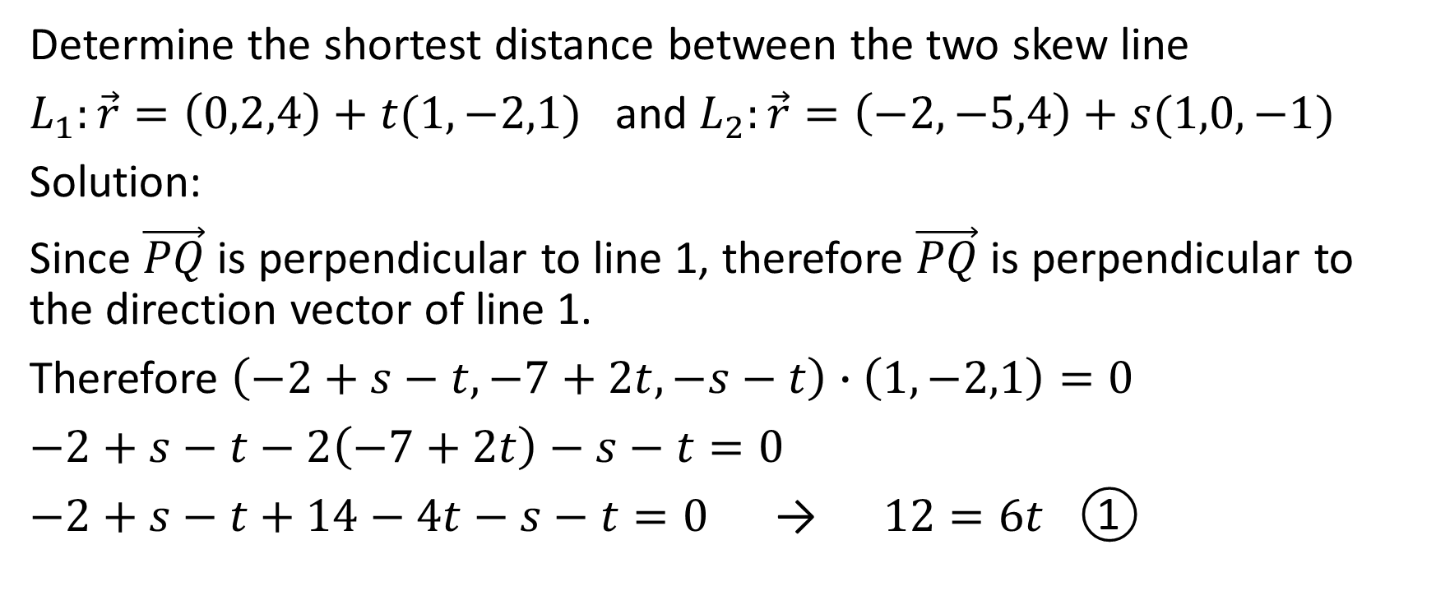
Determine the shortest distance between the two skew line
$L_{1}:\vec{r}=\left(0,2,4\right)+t(1,−2,1)$ and $L_{2}:\vec{r}=\left(−2,−5,4\right)+s(1,0,−1)$
Solution:
Since $\vec{PQ}$ is perpendicular to line 1, therefore $\vec{PQ}$ is perpendicular to the direction vector of line 1.
Therefore $\left(−2+s−t,−7+2t,−s−t\right)∙\left(1,−2,1\right)=0$
$−2+s−t−2\left(−7+2t\right)−s−t=0$
$−2+s−t+14−4t−s−t=0$ → $12=6t$ ①

Slide 46
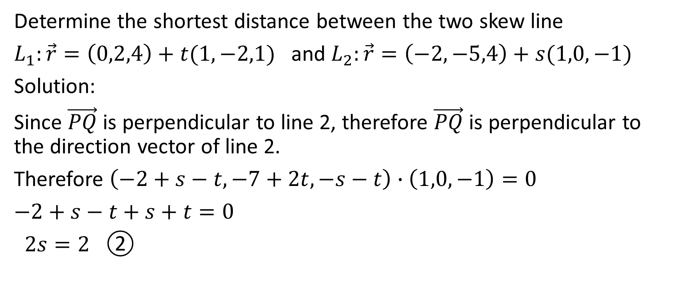
Determine the shortest distance between the two skew line
$L_{1}:\vec{r}=\left(0,2,4\right)+t(1,−2,1)$ and $L_{2}:\vec{r}=\left(−2,−5,4\right)+s(1,0,−1)$
Solution:
Since $\vec{PQ}$ is perpendicular to line 2, therefore $\vec{PQ}$ is perpendicular to the direction vector of line 2.
Therefore $\left(−2+s−t,−7+2t,−s−t\right)∙\left(1,0,−1\right)=0$
$−2+s−t+s+t=0$
$2s=2$ ②

Slide 47

Determine the shortest distance between the two skew line
$L_{1}:\vec{r}=\left(0,2,4\right)+t(1,−2,1)$ and $L_{2}:\vec{r}=\left(−2,−5,4\right)+s(1,0,−1)$
Solution:
$12=6t\text{ ①}$ 2s = 2 ②

Slide 48
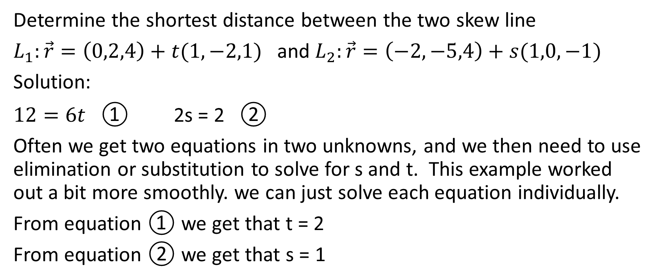
Determine the shortest distance between the two skew line
$L_{1}:\vec{r}=\left(0,2,4\right)+t(1,−2,1)$ and $L_{2}:\vec{r}=\left(−2,−5,4\right)+s(1,0,−1)$
Solution:
$12=6t\text{ ①}$ 2s = 2 ②
Often we get two equations in two unknowns, and we then need to use elimination or substitution to solve for s and t. This example worked out a bit more smoothly. we can just solve each equation individually.
From equation ① we get that t = 2
From equation ② we get that s = 1

Slide 49
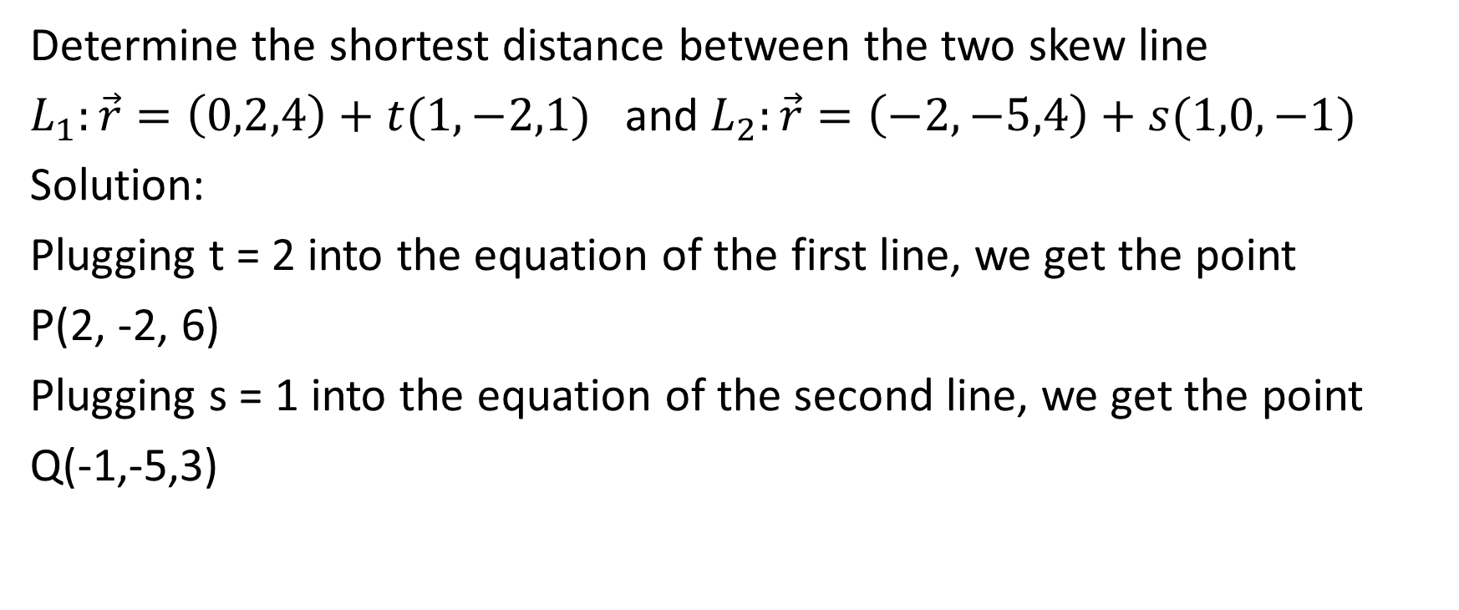
Determine the shortest distance between the two skew line
$L_{1}:\vec{r}=\left(0,2,4\right)+t(1,−2,1)$ and $L_{2}:\vec{r}=\left(−2,−5,4\right)+s(1,0,−1)$
Solution:
Plugging t = 2 into the equation of the first line, we get the point
P(2, -2, 6)
Plugging s = 1 into the equation of the second line, we get the point
Q(-1,-5,3)

Slide 50
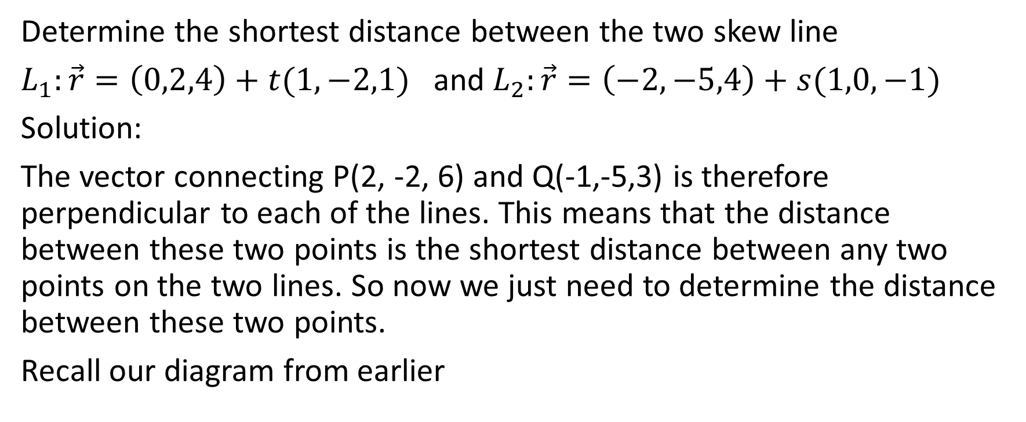
Determine the shortest distance between the two skew line
$L_{1}:\vec{r}=\left(0,2,4\right)+t(1,−2,1)$ and $L_{2}:\vec{r}=\left(−2,−5,4\right)+s(1,0,−1)$
Solution:
The vector connecting P(2, -2, 6) and Q(-1,-5,3) is therefore perpendicular to each of the lines. This means that the distance between these two points is the shortest distance between any two points on the two lines. So now we just need to determine the distance between these two points.
Recall our diagram from earlier

Slide 51
Determine the shortest distance between the two skew line
$L_{1}:\vec{r}=\left(0,2,4\right)+t(1,−2,1)$ and $L_{2}:\vec{r}=\left(−2,−5,4\right)+s(1,0,−1)$
Solution:
.
Q
Line 2
.
Line 1
P

Slide 52
Determine the shortest distance between the two skew line
$L_{1}:\vec{r}=\left(0,2,4\right)+t(1,−2,1)$ and $L_{2}:\vec{r}=\left(−2,−5,4\right)+s(1,0,−1)$
Solution:
.
Q (-1,-5,3)
Line 2
We now know the coordinates of point P and point Q
.
Line 1
P (2,-2,6)

Slide 53

Determine the shortest distance between the two skew line
$L_{1}:\vec{r}=\left(0,2,4\right)+t(1,−2,1)$ and $L_{2}:\vec{r}=\left(−2,−5,4\right)+s(1,0,−1)$
Solution:
.
Q (-1,-5,3)
Line 2
We now know the coordinates of point P and point Q
.
Line 1
P (2,-2,6)
$$\vec{PQ}=\vec{(−3,−3,−3)}$$

Slide 54
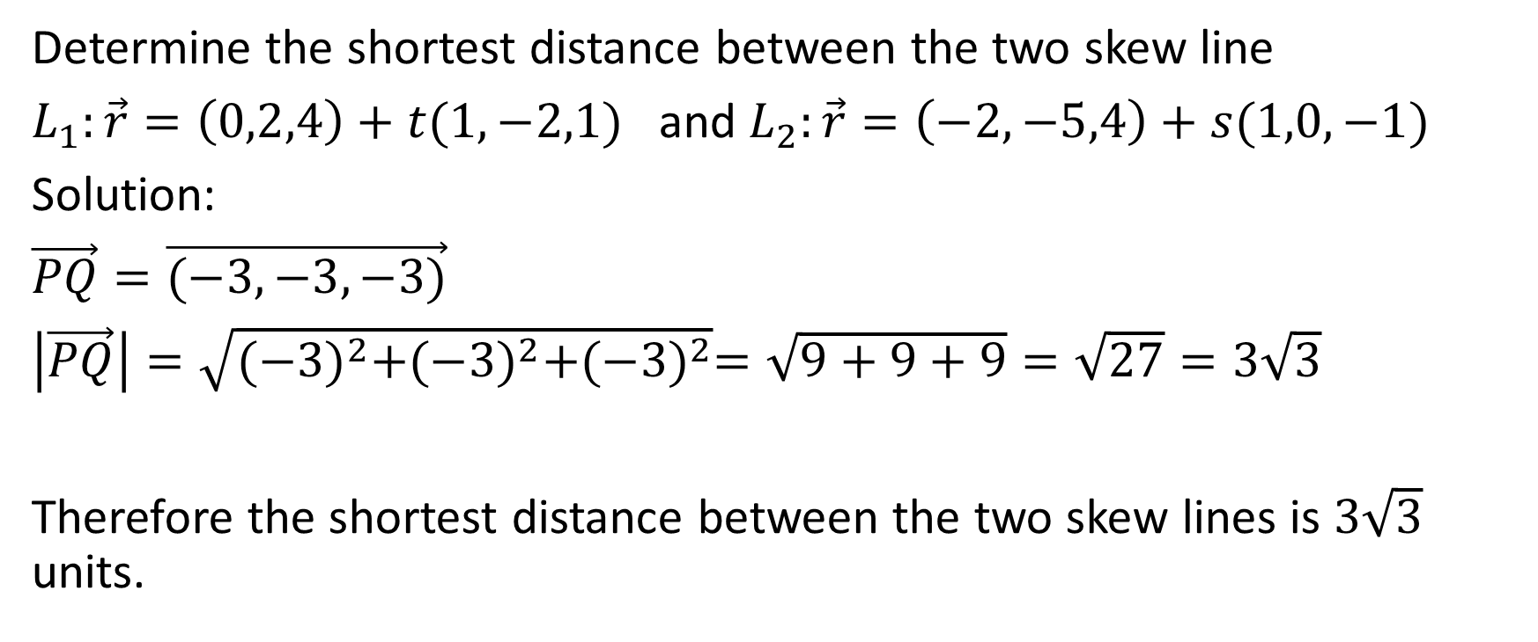
Determine the shortest distance between the two skew line
$L_{1}:\vec{r}=\left(0,2,4\right)+t(1,−2,1)$ and $L_{2}:\vec{r}=\left(−2,−5,4\right)+s(1,0,−1)$
Solution:
$\vec{PQ}=\vec{(−3,−3,−3)}$
$\left|\vec{PQ}\right|=\sqrt{{(−3)}^{2}+{(−3)}^{2}+{(−3)}^{2}}=\sqrt{9+9+9}=\sqrt{27}=3\sqrt{3}$
Therefore the shortest distance between the two skew lines is $3\sqrt{3}$ units.

Slide 55
The advantage of the second method is that you actually find the point on each line that gives the shortest distance between the lines.
☺

